Slide 1
Hybrid UDP Covert Channel
Tart Stepfather
[Redacted]
[Redacted]
Jacob Foster

Slide 2
Overview
Problem Statement
Background
Assumptions
Tools and Techniques
Problem Solution
Risk Assessment
Summary

Slide 3
Problem Statement
Sensitive data exists on a device in a network
We have access to a .pcap file of network traffic
Design and develop a covert channel
Exfil data from target to our local device
Analyse covert channel with respect to five metrics: bandwidth, detection, permissiveness, prevention, difficulty

Slide 4
Background
Covert channel: communication channel that violates the intended security protocols of a system
UDP: communication protocol with low overhead, no reliable data delivery or integrity
Plaintext vs ciphertext: unencrypted vs encrypted data
Substitution cipher: a function used to encrypt data by shifting elements by a certain value
Sockets: endpoints between two nodes on a network, sockets bind to ports

Slide 5
Assumptions
Client already exists on and can execute on target device
The data we wish to exfiltrate is a text file
Both client and server remain on during data exfiltration
These assumptions allow us to focus on channel reliability and stealth

Slide 6
Tools and Techniques
Wireshark (Version 3.4.6)
Python (Version 3.9.6)
.NET framework C# (Version 4.7.2)
Polyalphabetic cipher
SHA256 hashes

Slide 7
Protocol Decision Matrix - Estimate
Protocol | Bandwidth | Detection | Permissiveness | Prevention | Difficulty | Total
UDP | 1 | 2 | 3 | 1 | 3 | 10
ICMP | 1 | 5 | 3 | 4 | 1 | 14
TLS | 5 | 2 | 3 | 1 | 4 | 15
HTTP | 3 | 4 | 3 | 1 | 3 | 14

Slide 8
Encrypted Communications
Parse user input into ASCII decimal
2. Generate a random key between 0 and 15
3. Encrypt a plaintext ASCII decimal value with a key
4. Generate X ASCII characters where X is the value of
the data we wish to send
5. Embed the key inside the data field in our datagram and
send the UDP datagram to the server

Slide 9
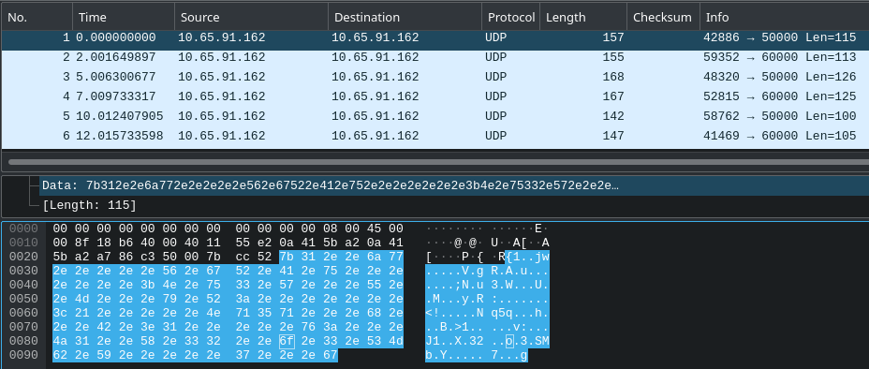
Encrypted Communications
Key: 3
Encrypted Data: 115

Slide 10
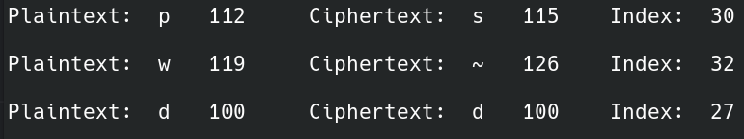
Encrypted Communications
6. The server receives the datagram from the client
7. The server parses the “DATA” section and retrieves the key
8. The server decrypts the message once the key is found

Slide 11





Reliable Delivery
Through acknowledgment datagrams
Message identifiers and server array
Re-implementation of sockets in server and client
Asynchronous functions
Client retransmission time of 2s
Server retransmission count of 3
1
1
2

Slide 12
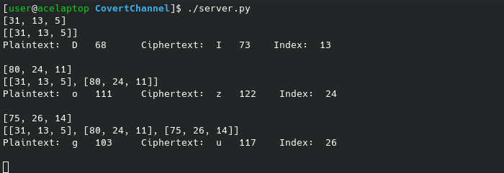
Message Identifier 1
[lengthMessage, key, index]

Slide 13
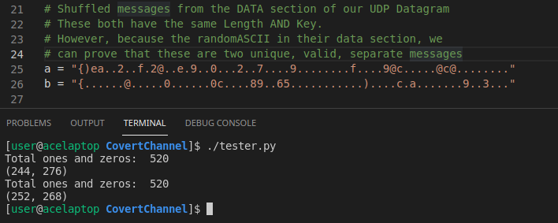
Message Identifier 2
[lengthMessage, key, countOnes, countZeros]

Slide 14
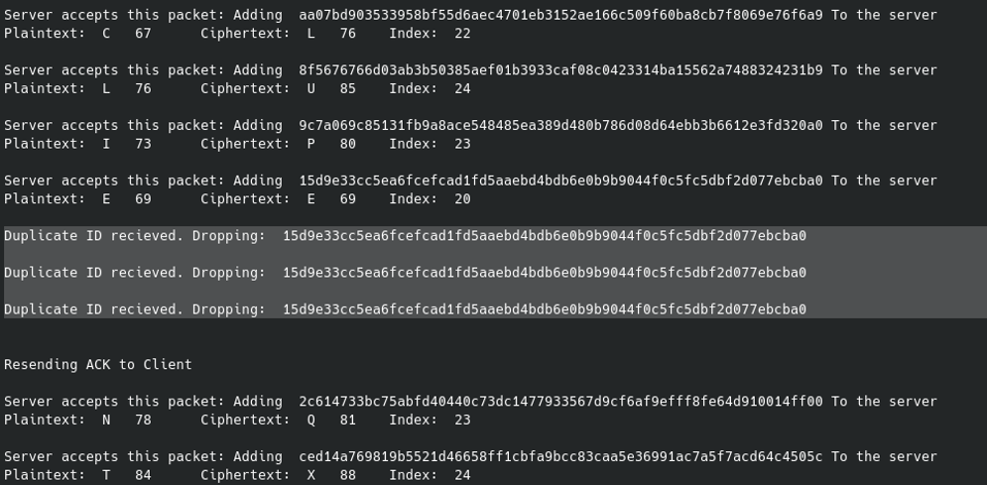
Message Identifier 3
[datafieldHash]

Slide 15
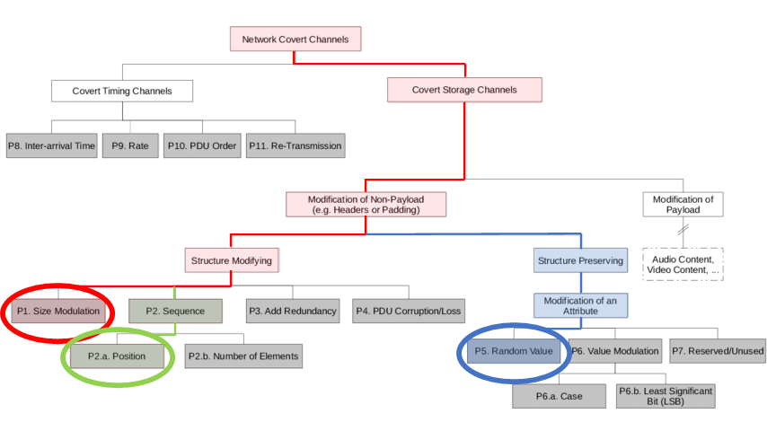

Slide 16
P1. Size Modulation
Communicate information via modulating the size of the “data” field in UDP datagrams
P2.a. Position
Altering the position of our key in the datagram’s “data” field

Slide 17
P5. Random Value
We create random ASCII characters in our datagrams “data” field to blend in with surrounding UDP traffic

Slide 18
Metrics
Bandwidth: server unoptimized, low bandwidth 3.2 bits/sec
Detection: indistinguishable from target network UDP traffic
Permissiveness: legitimate UDP traffic
Prevention: only possible to single out source/destination IP
Difficulty: encryption, delivery reliability for UDP
Protocol | Bandwidth | Detection | Permissiveness | Prevention | Difficulty | Total
UDP | 5 | 1 | 1 | 1 | 5 | 13

Slide 19
Risk Analysis
If the data we wish to exfil is not text-based:
We must implement a new exfil method that can encode
and transmit the file itself, not just the contents of the file.
If we are unable to execute our code on the target:
We must implement a way to have our code run on
the target machine via other means.
If the client and server do not remain on during data exfil:
We must implement a method to resync the client and the server if either temporarily lose contact with each other

Slide 20
Summary
Problem Statement
Background
Assumptions
Tools and Techniques
Problem Solution
Risk Assessment
Summary

Slide 21
Hybrid UDP Covert Channel
Questions?

